Slide 1

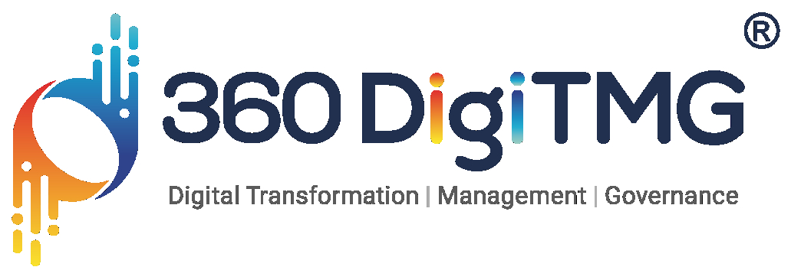
Optimizing Bus Operations with Data Driven Insights
Done By:
ALLAM SRIDHAR

Slide 2
Contents
Business Objective
Business Constraints
Project Architecture - Data Flow Diagram
Data Collection
Exploratory Data Analysis
Data Visualization
Notes:
Change

Slide 3
Business Problem
Client: A Leading Bus Transportation Company
Business Problem: The company struggles to understand passenger trends (travel patterns), fare pricing to boost revenue, and schedule buses effectively during peak hours
Business Objective: The company aims to leverage ticket sales data to improve pricing strategies and optimize service schedules
Business Constraint: Ensure data accuracy, account for missing or inconsistent entries, and adhere to privacy regulations while analyzing and visualizing insights
Business Success Criteria: Improve on-time performance and service availability by aligning schedules with peak travel times
Economic Success Criteria: Identify pricing strategies that maximize ticket sales and revenue during peak and off-peak hours

Slide 4
Project Overview and Scope
Project Overview:
A leading bus transportation company seeks to optimize pricing and scheduling using ticket sales data. By analyzing travel patterns, fare structures, and demand trends, the project aims to enhance revenue, improve service efficiency, and ensure data accuracy and compliance.
Project Scope:
Data Collection & Cleaning – Refine ticket sales data Travel Pattern Analysis – Identify patterns Pricing Optimization – Develop data-driven fare strategies Bus Scheduling Optimization – Align schedules with demand Visualization & Reporting – Deliver insights via dashboards

Slide 5
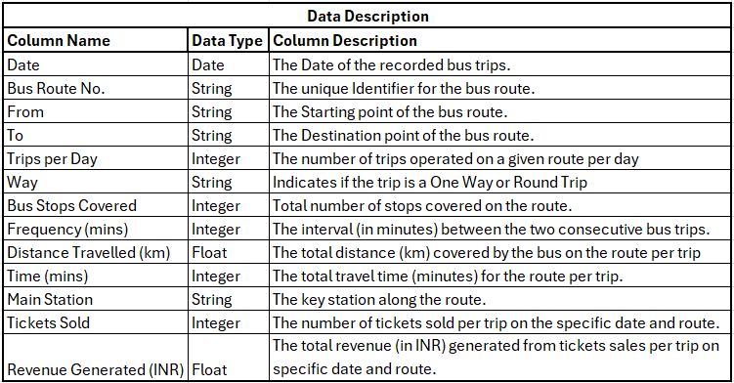
Data Dictionary

Slide 6
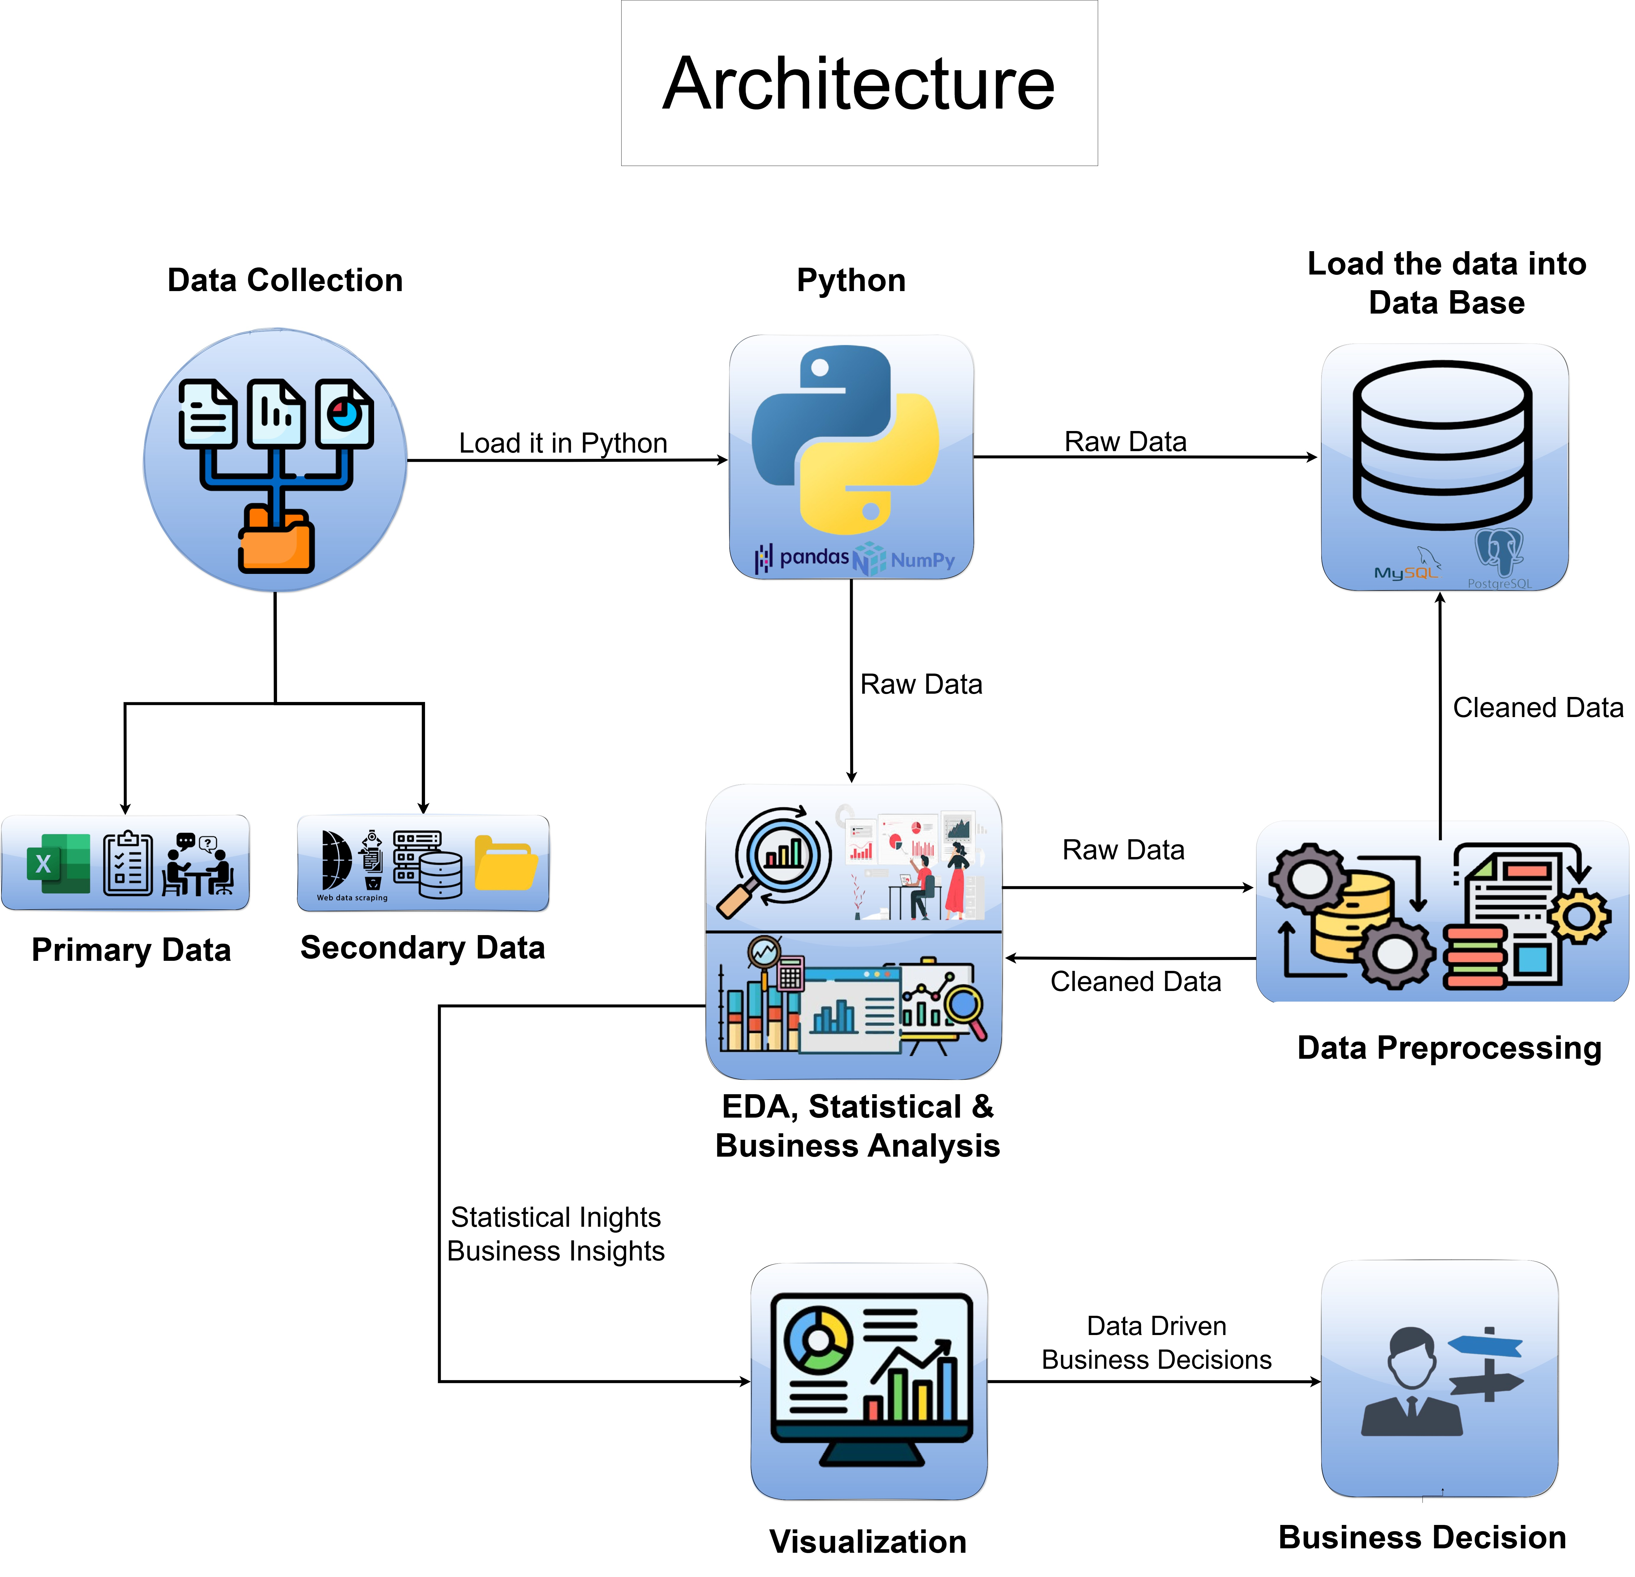
Project Architecture

Slide 7
Exploratory Data Analysis [EDA]
Statistical Insights
Business Insights
Distribution Patterns
Trips per Day shows a right-skewed distribution with most routes having 0-50 trips, and outliers up to 150+ trips
Distance Travelled follows a relatively normal distribution centered around 40-60 km
Revenue Generated shows a highly right-skewed distribution with most values concentrated in lower ranges
Bus Stops Covered displays a roughly uniform distribution between 10-40 stops
Correlation Analysis
Strong positive correlation between Time and Distance Travelled (r ≈ 0.8)
Moderate positive correlation between Bus Stops and Distance (r ≈ 0.5)
Weak to no correlation between Tickets Sold and Distance Travelled
Negative correlation between Frequency and Revenue Generated
Outlier Patterns
Significant outliers in Trips per Day (>150 trips)
Revenue Generated shows extreme values >100,000 INR
Tickets Sold has outliers >3000 tickets
Time duration shows consistent patterns with few outliers
Route Optimization
Most profitable routes have 20-30 bus stops
Optimal journey time appears to be 60-80 minutes
Routes with moderate frequency (15-30 mins) show better revenue generation
Long-distance routes (>80 km) show lower ticket sales
Revenue Patterns
Higher revenue concentration in short to medium distance routes
Peak revenue generation occurs during specific frequency windows
Ticket sales don't linearly correlate with revenue, suggesting variable pricing
Routes with moderate bus stops (15-25) generate more consistent revenue
Operational Efficiency
Most routes operate within 40-80 minute duration window
Optimal bus stop spacing improves overall journey times
High-frequency routes don't necessarily translate to higher revenue
Routes with balanced stops-to-distance ratio show better performance
Notes:
EDA is used for seeing what the data can tell us before the modeling task.
Change

Slide 8
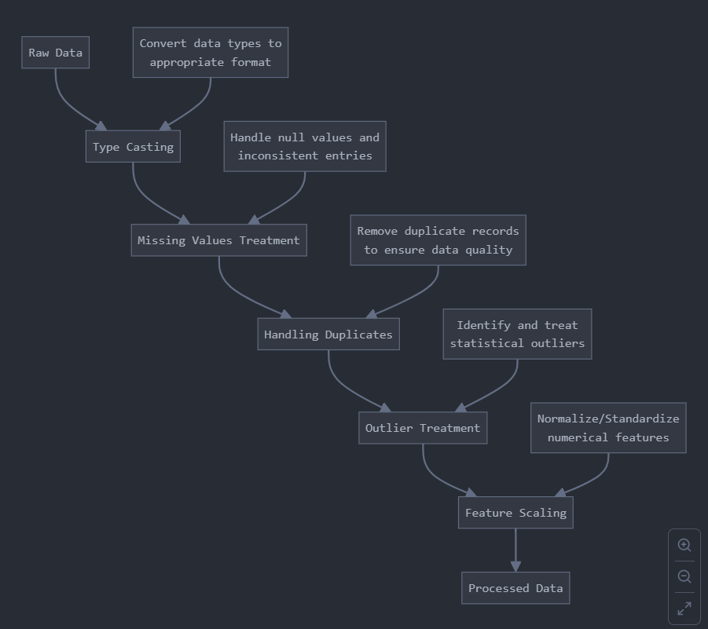
Data Preprocessing
Notes:
Keep observations

Slide 9
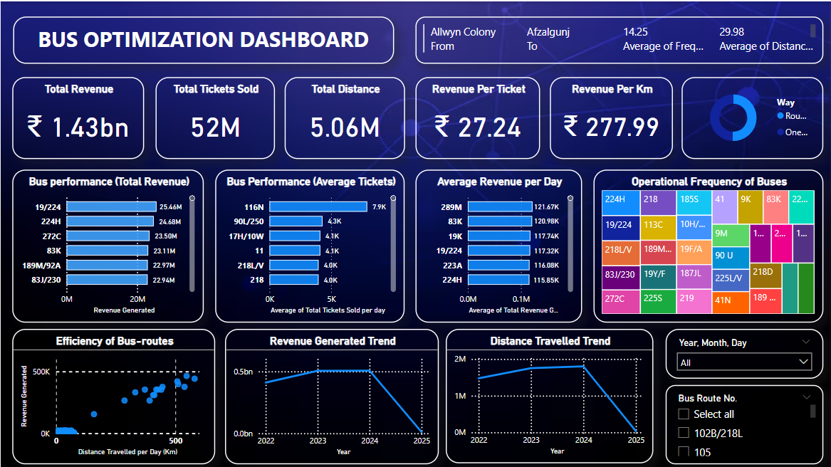
Data Visualization
Notes:
Add graphical

Slide 10


